Slide 1

Online Hotel Booking Website
Group Name – Fab5
Team Members Student ID
Aziz Husaini Doctor C0769072
Amanpreet Kaur C0771697
Rajinder Kaur C0769584
Sandeep kaur C0772219
Suman Suman C0769874
Click on the below link to download our project :
https://github.com/azdoc/Fab5-Hotels

Slide 2
Task Done Specification
Team member Name | Web Pages | Task Assigned Description
Aziz Husaini Doctor | Home Page | Navigation, Header and Home Page Along with merging of all website
Rajinder Kaur | Booking | Booking and availability form with validations and Responsiveness
Suman Suman | Gallery | Handle Gallery Images
Amanpreet Kaur | Contact Us | Footer, Contact Us form and Presentation
Sandeep kaur | About Us | About website description along with services provided.

Slide 3
Screenshots…

Slide 4
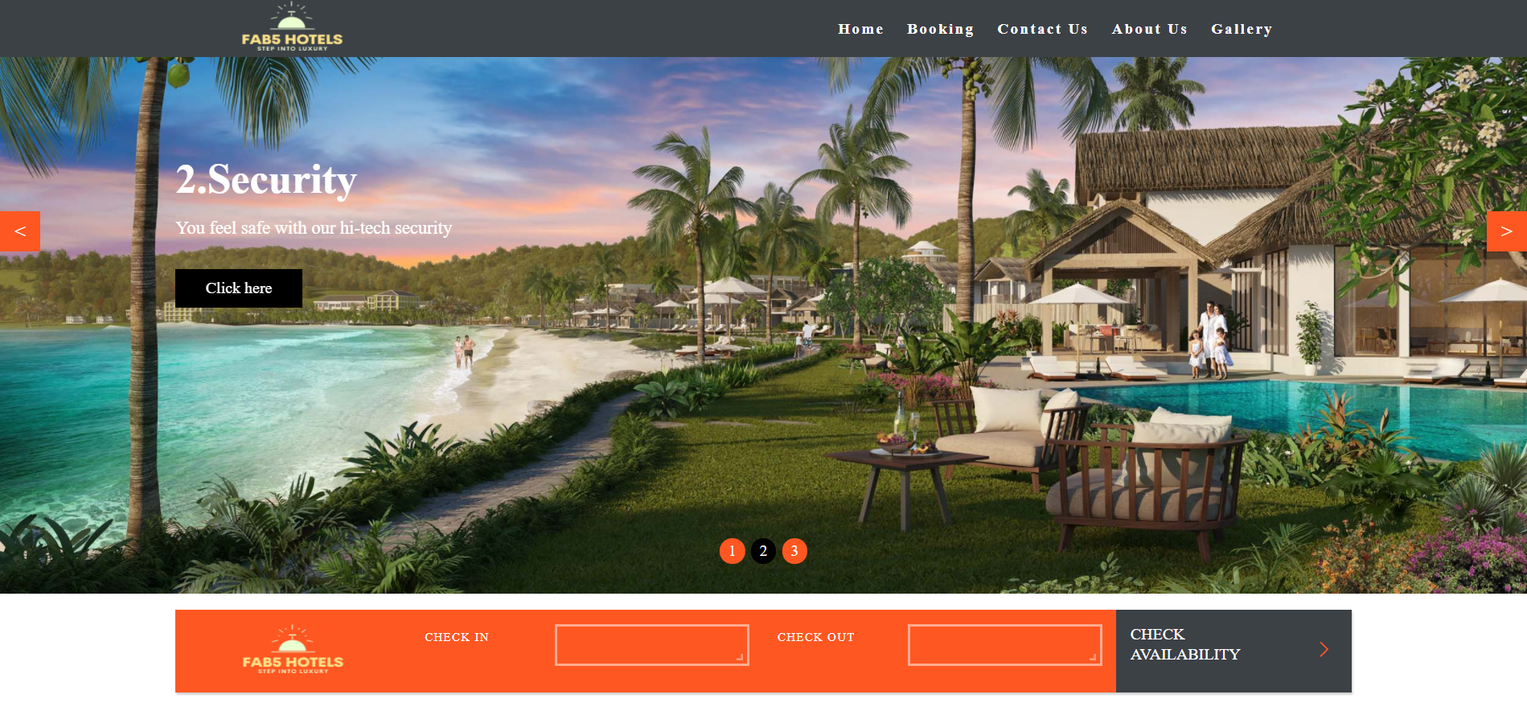
Home Page
Navigation menu on the top and below that, banner images that slide using JavaScript.
Check booking availability form with all required validations using JavaScript.

Slide 5
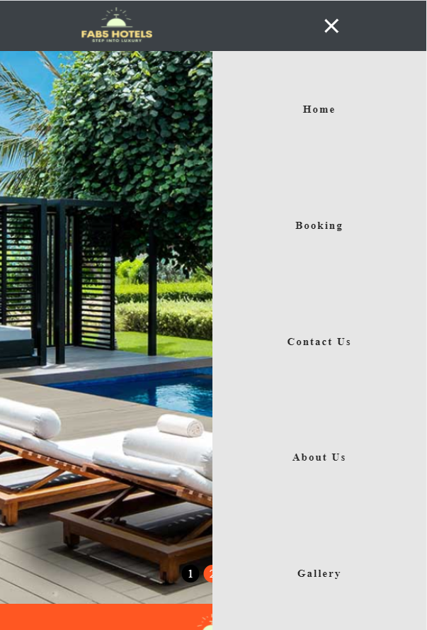
Home Page
Responsive homepage design transforms the horizontal menu to a vertical menu with slide in slide out.

Slide 6
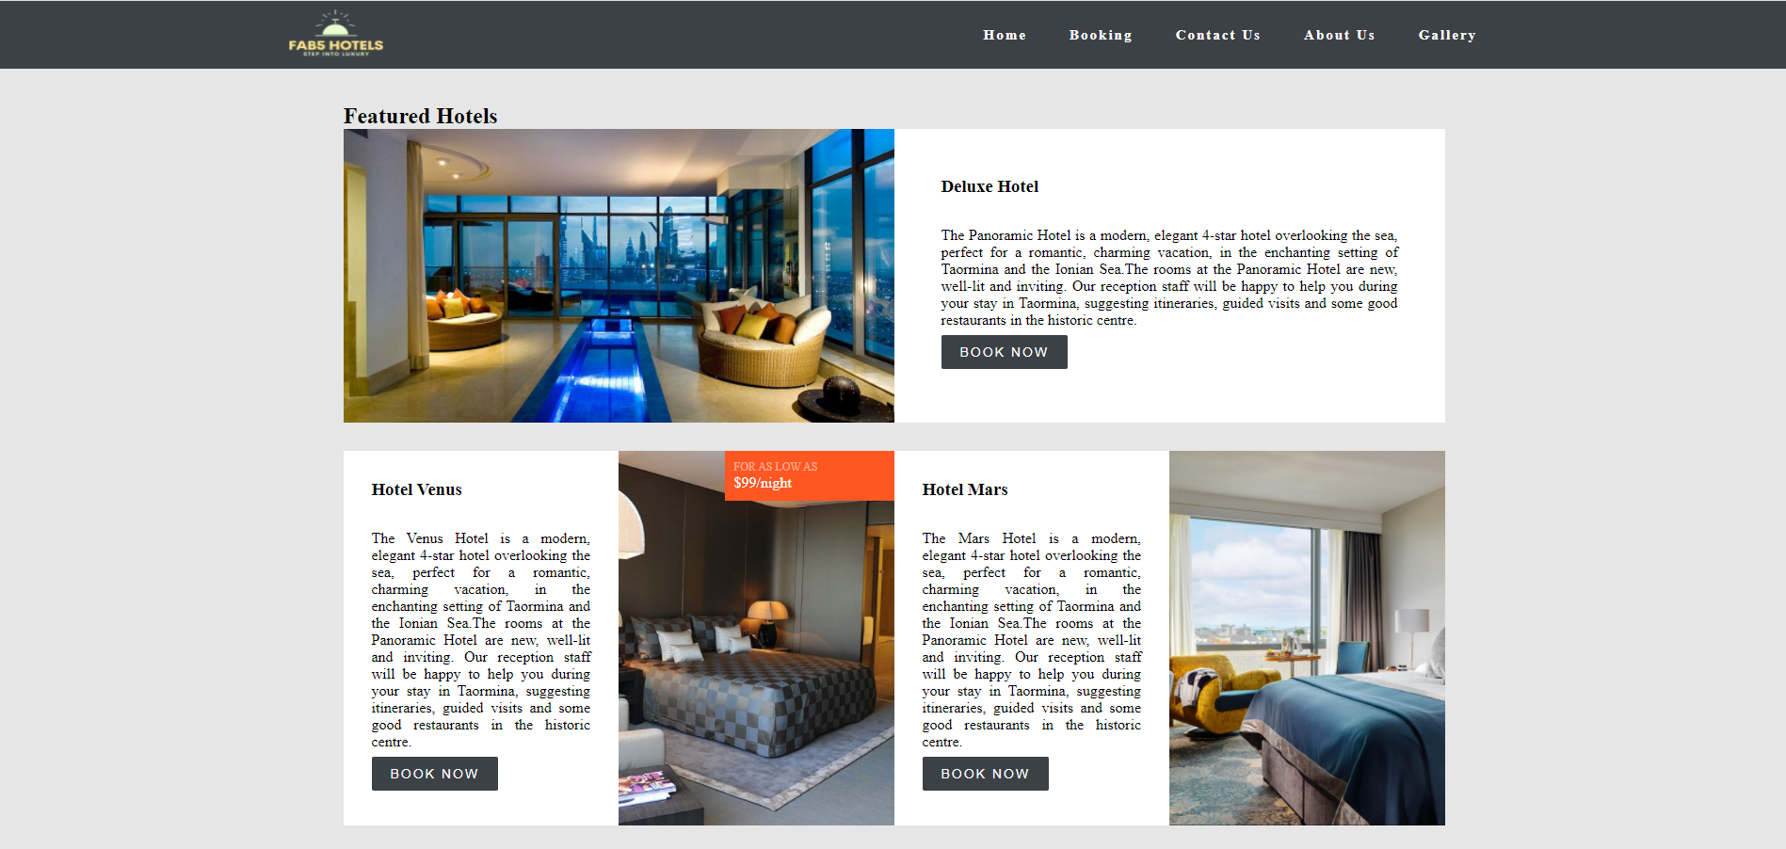
Displaying all chain of hotels with descriptions and showing rates on hover

Slide 7
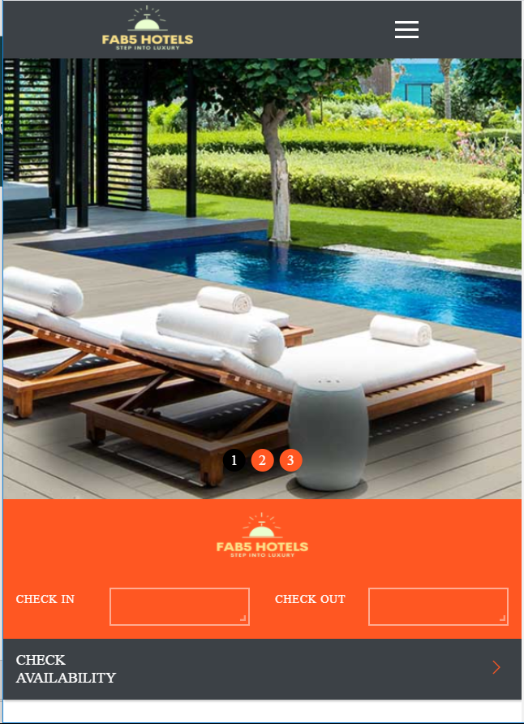
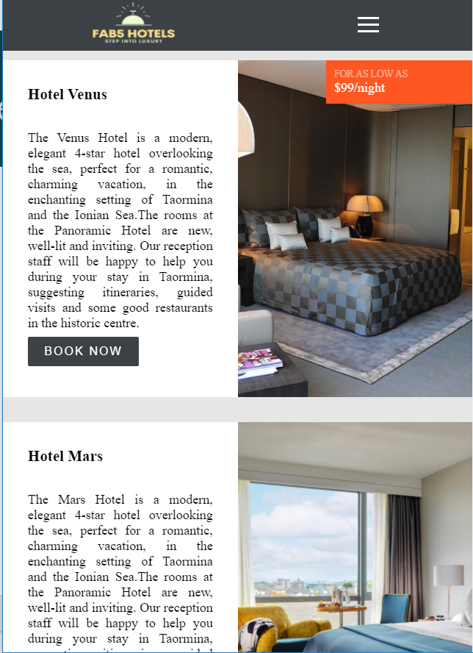
Responsive design

Slide 8
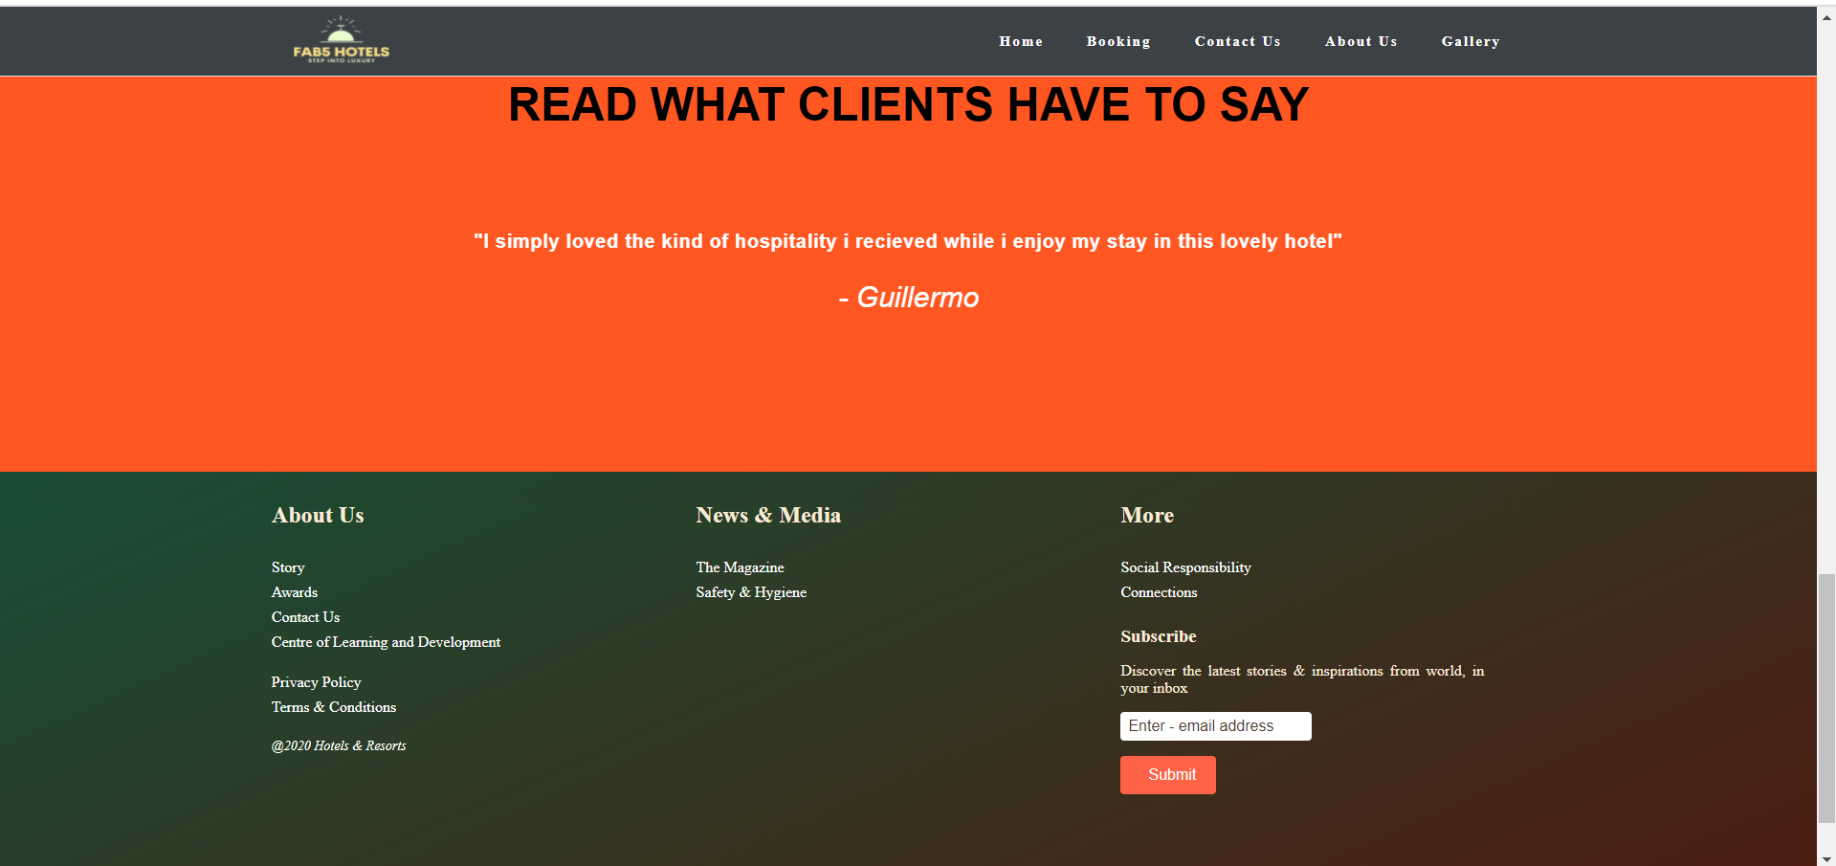
Testimonials at the bottom of the homepage with slider using css webkit - animation

Slide 9
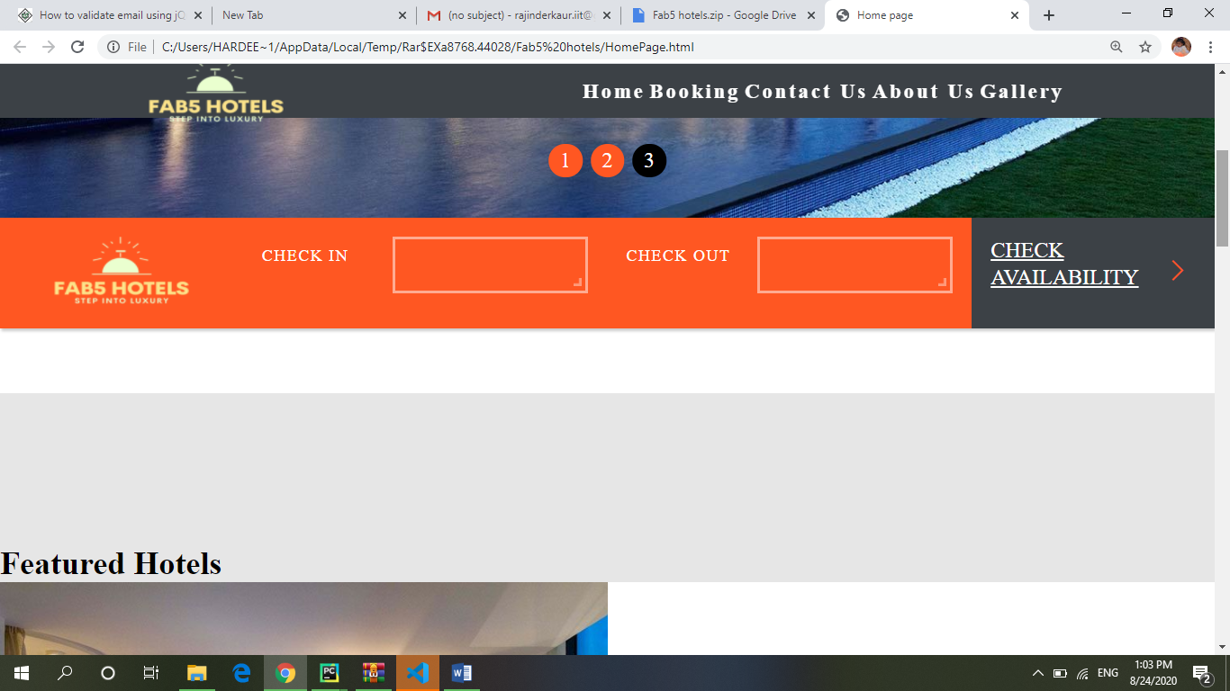
Booking Page
Check Availability Form

Slide 10
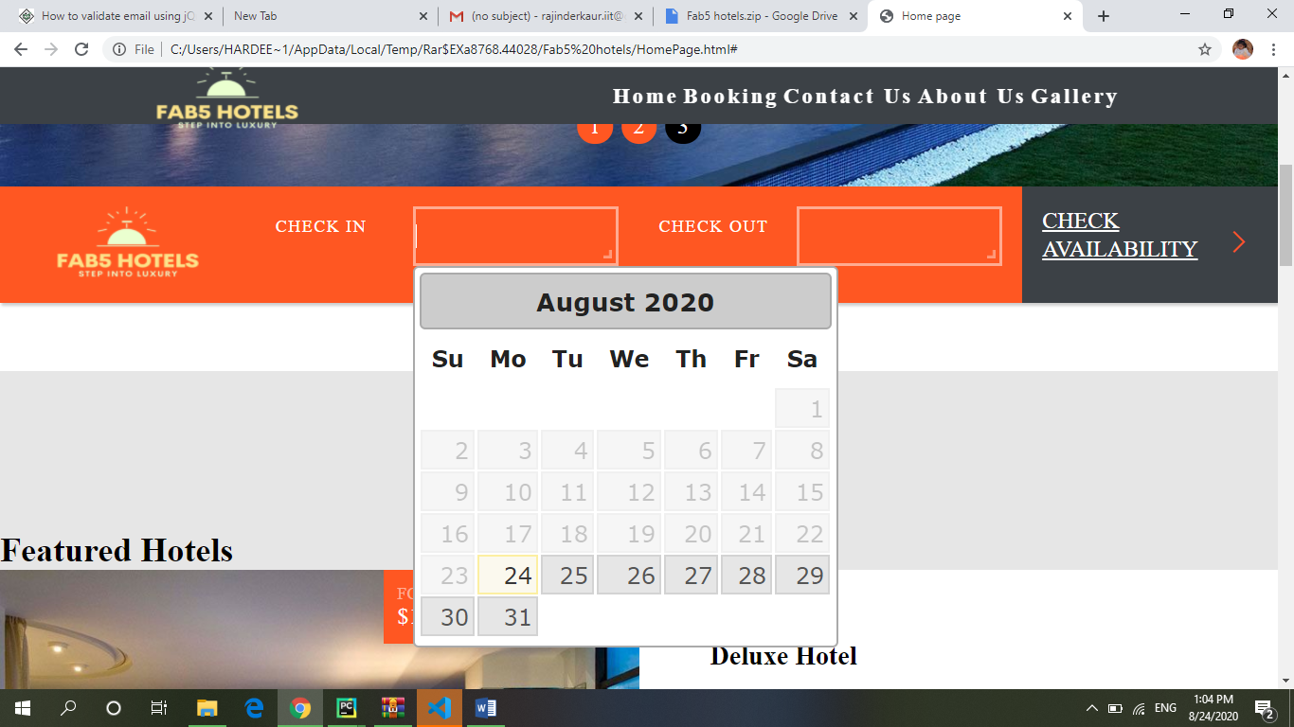
Added calendar at check In.

Slide 11
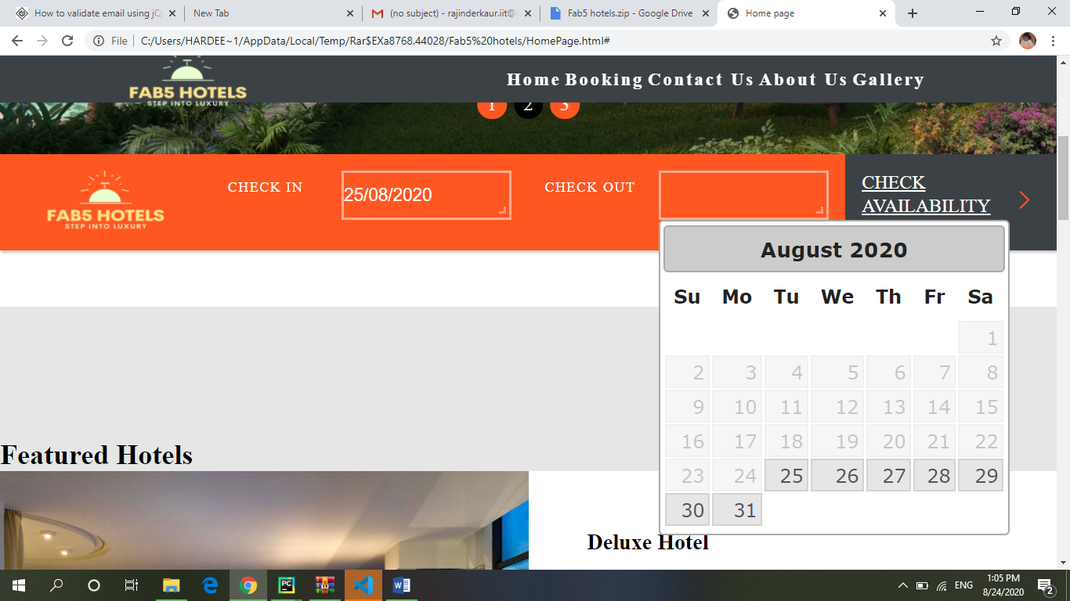
Added calendar at check Out

Slide 12
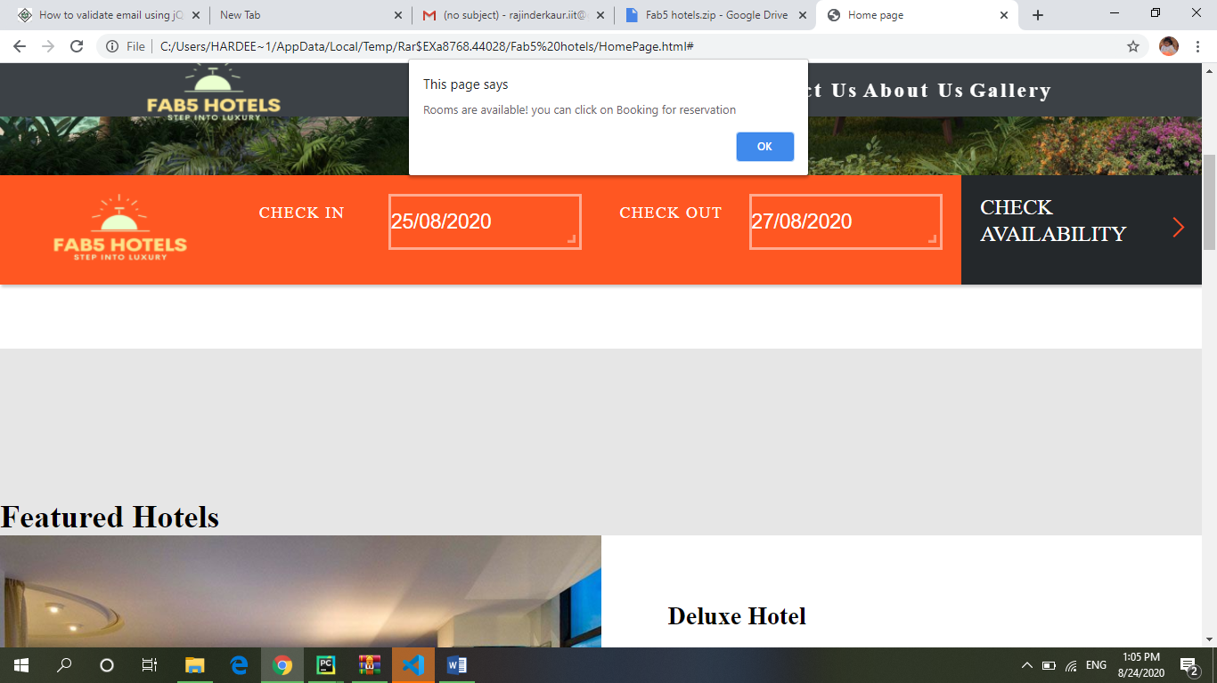
Onclick Event
On successful submission. Show alert message

Slide 13
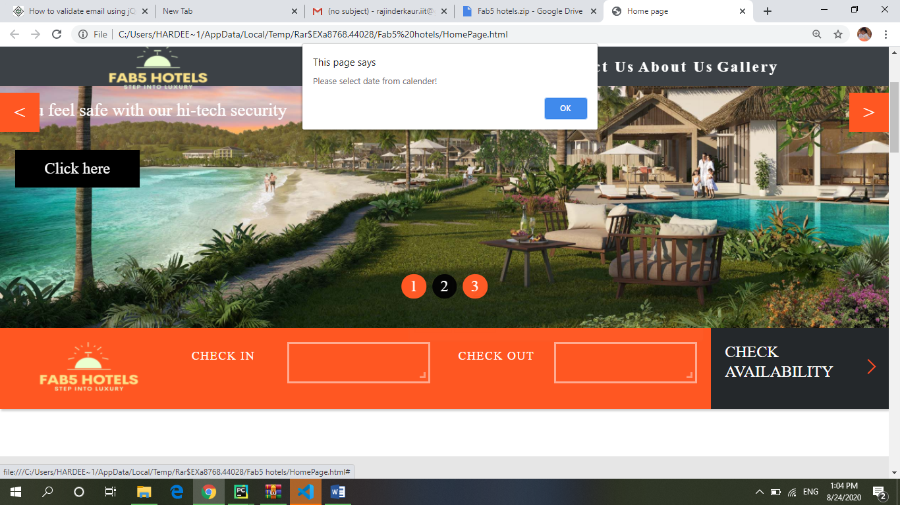
Alert message to fill input fields first

Slide 14
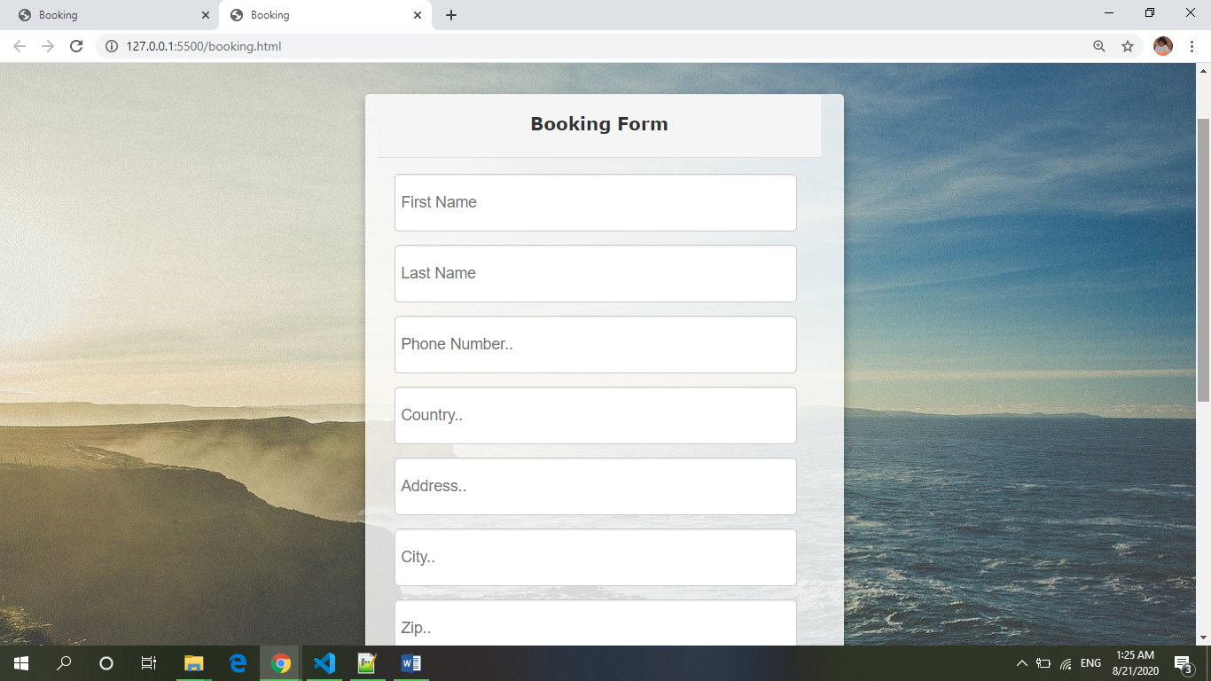
BOOKING FORM

Slide 15
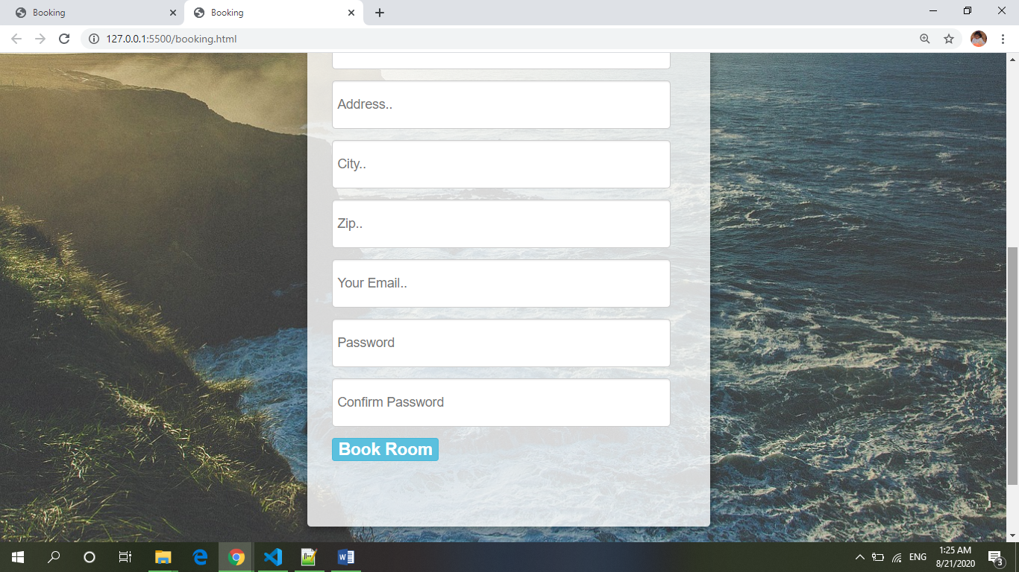
BOOKING FORM

Slide 16
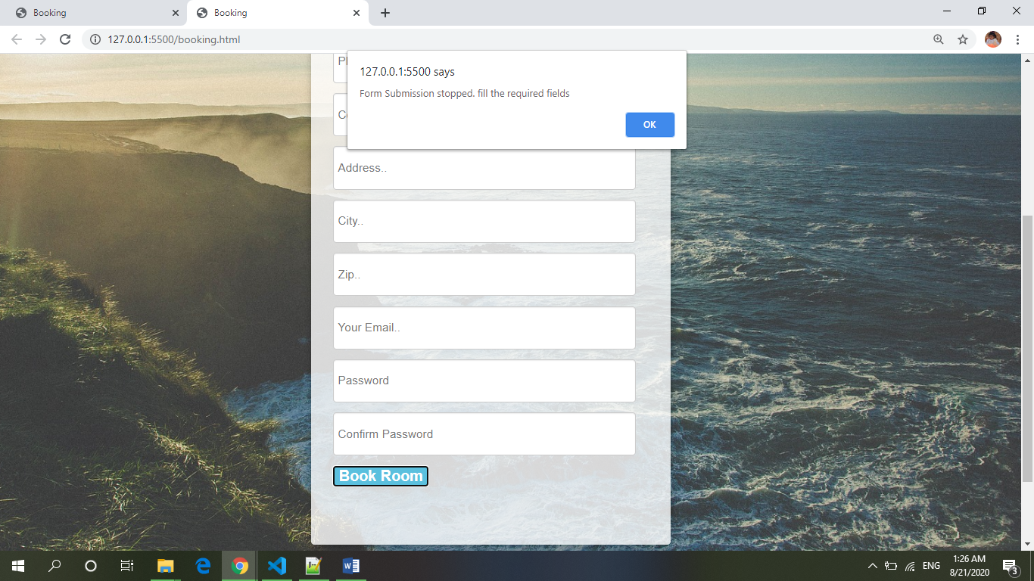
Used preventDefault() and show alert message if try to submit without information filled.

Slide 17
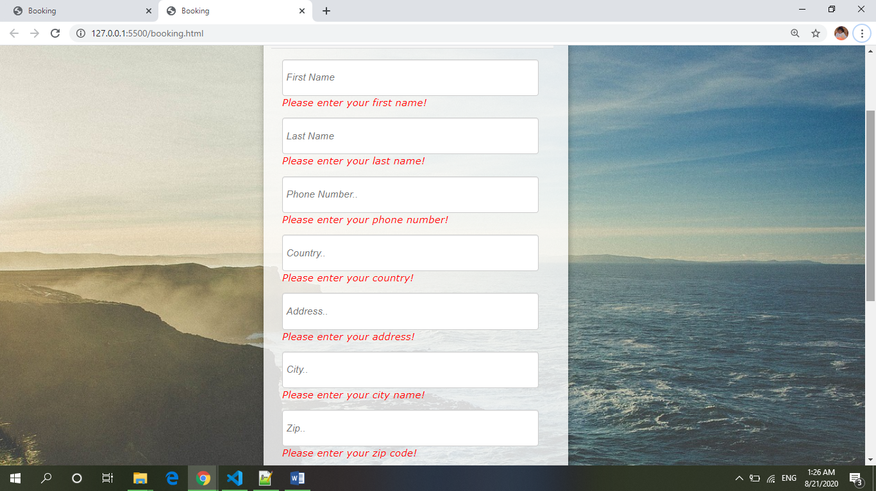
Validation

Slide 18
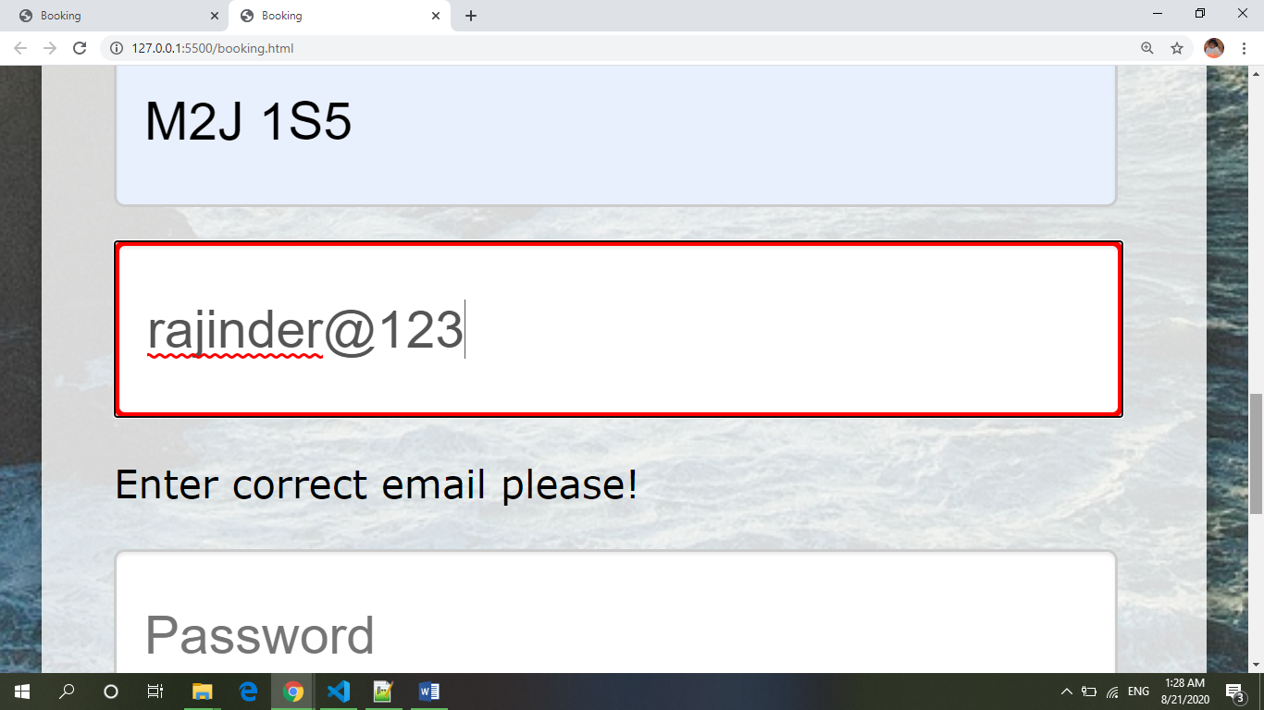
Email validation

Slide 19
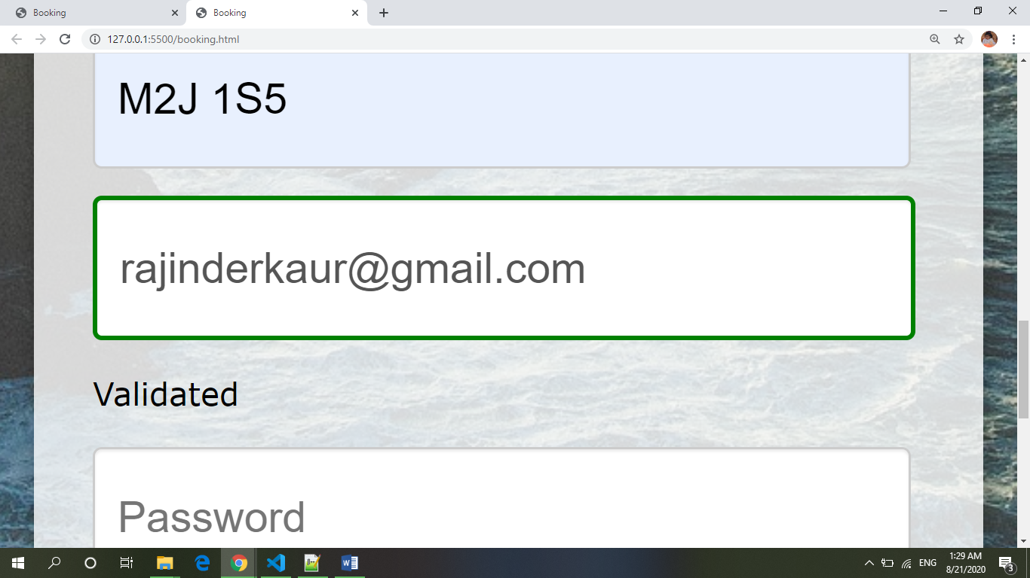
Email validation

Slide 20
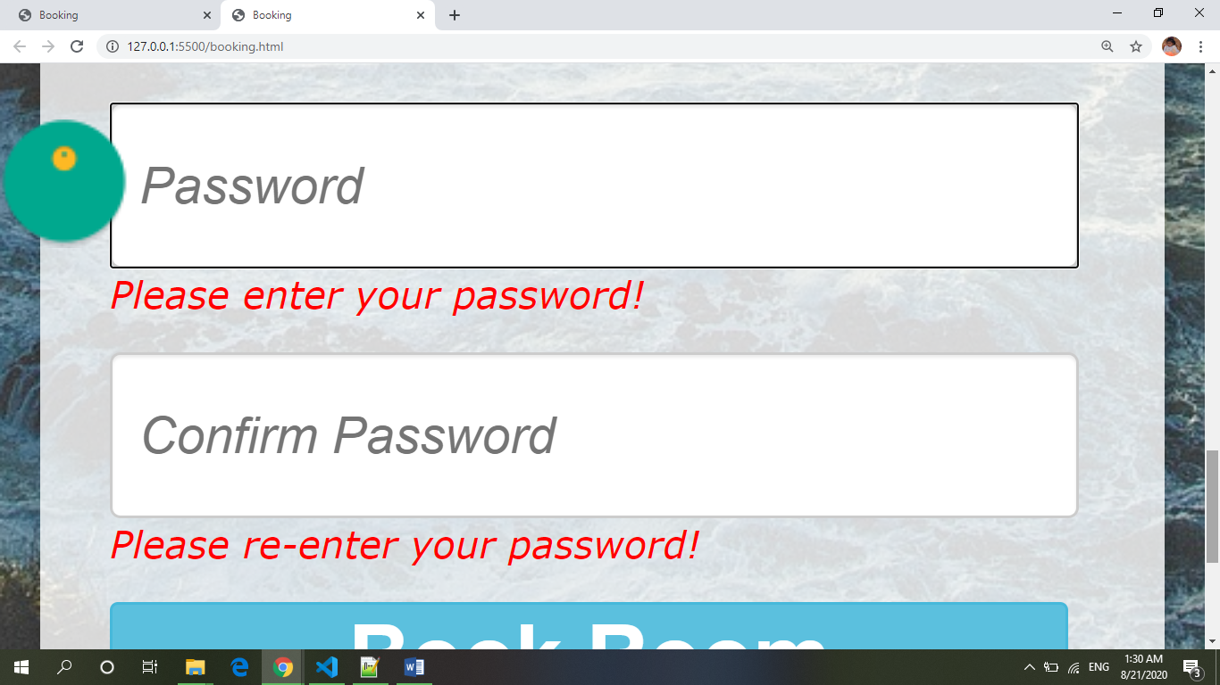
Password validation

Slide 21
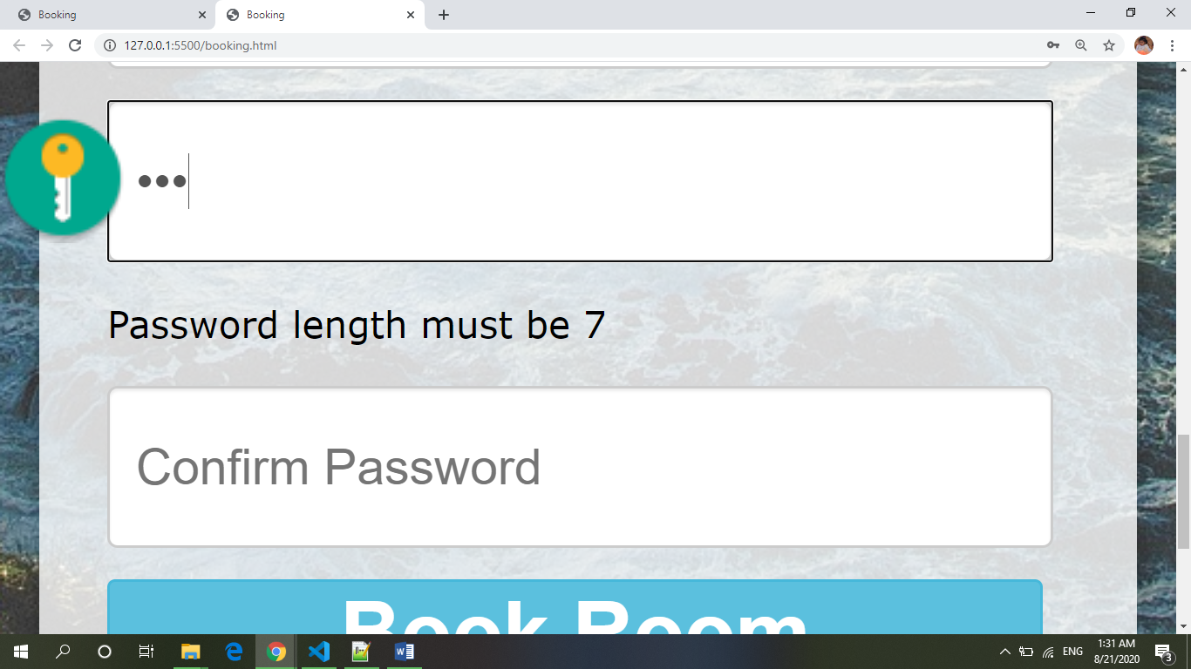
Set Password Length

Slide 22
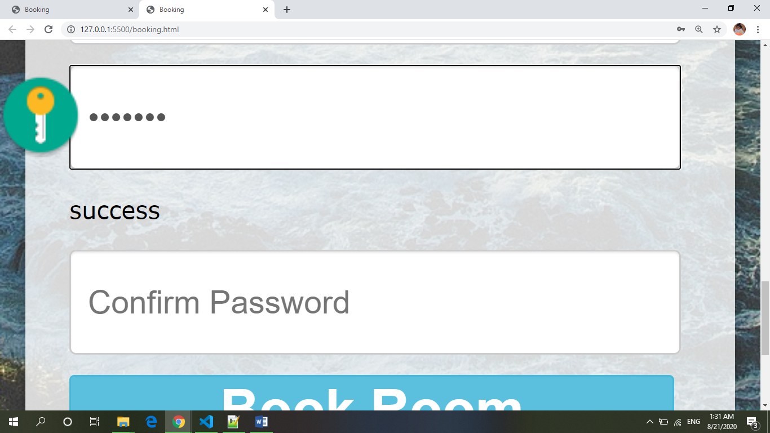
Show message after password validated

Slide 23
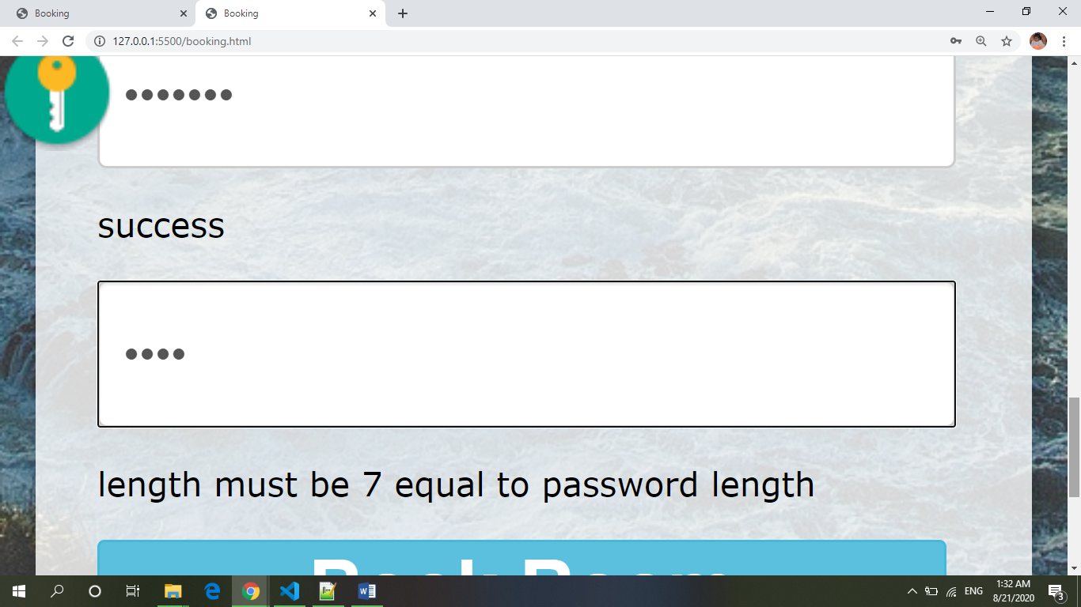
Confirm password Length should be equal to password

Slide 24
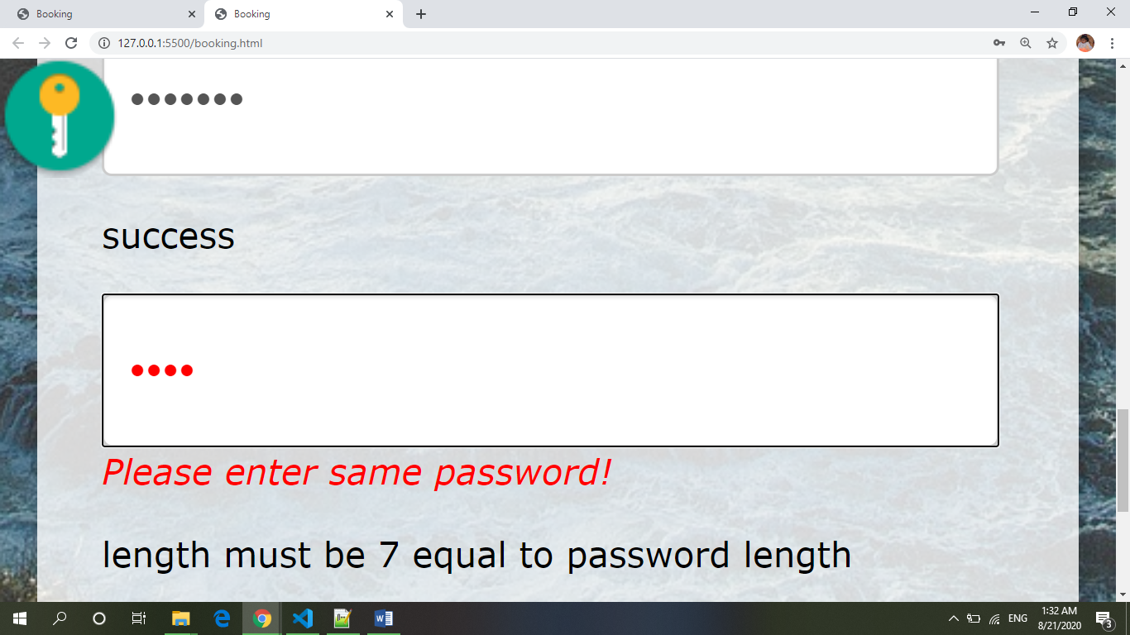
Validation for the same password to be enter

Slide 25
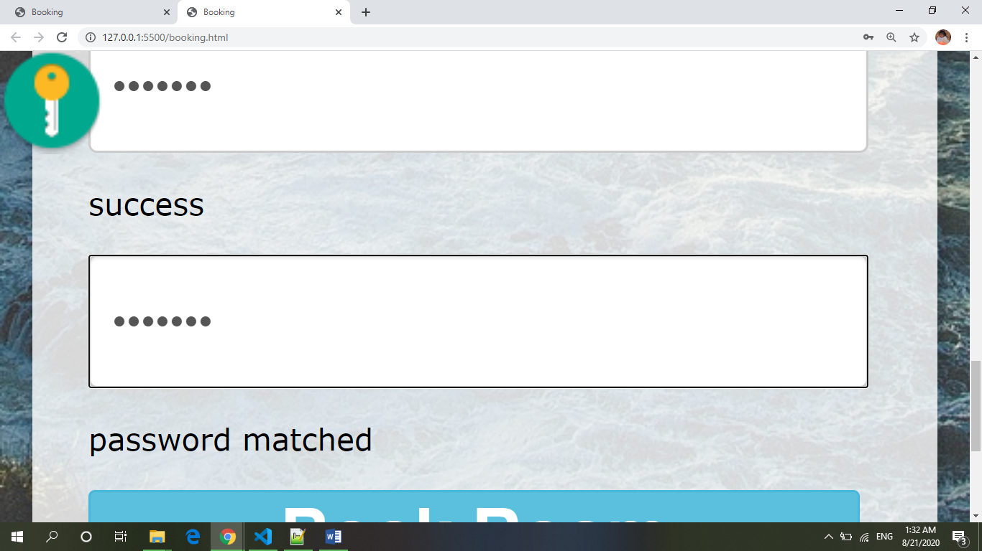
Validation for the password match successfully.

Slide 26
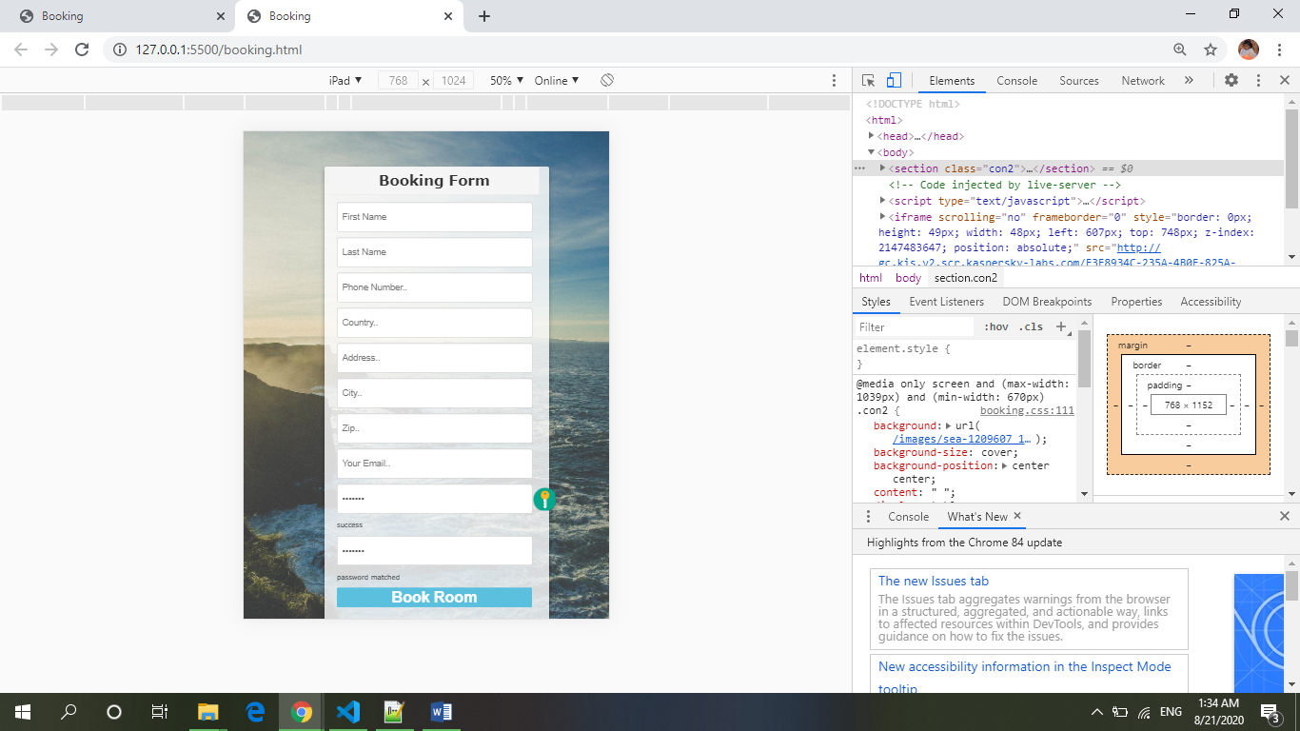
Responsive in different dimensions

Slide 27
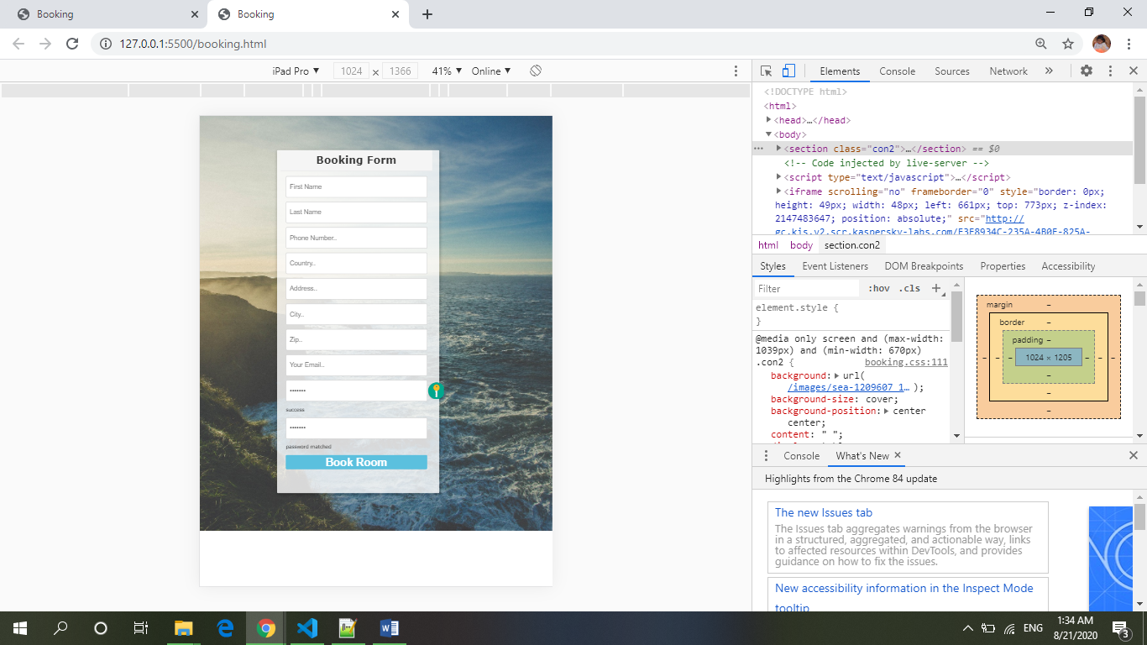
Responsive in different dimensions

Slide 28
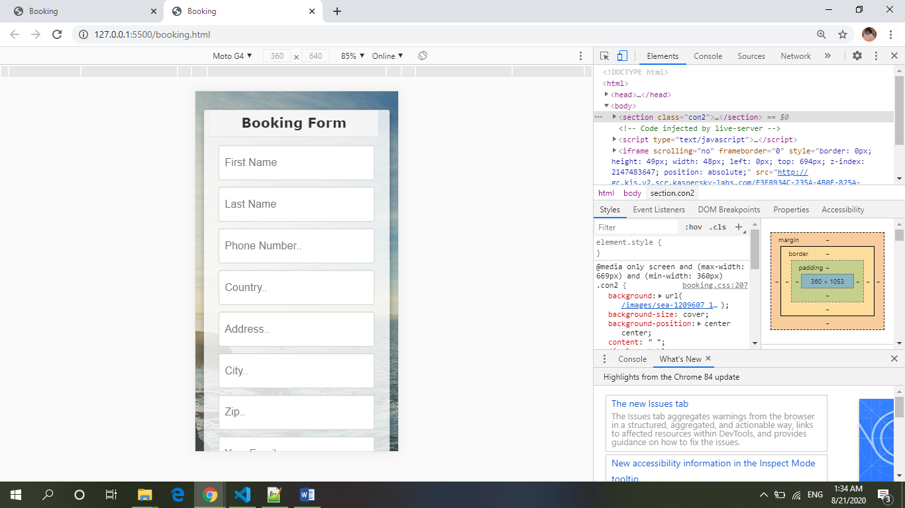
Responsive in different dimensions

Slide 29
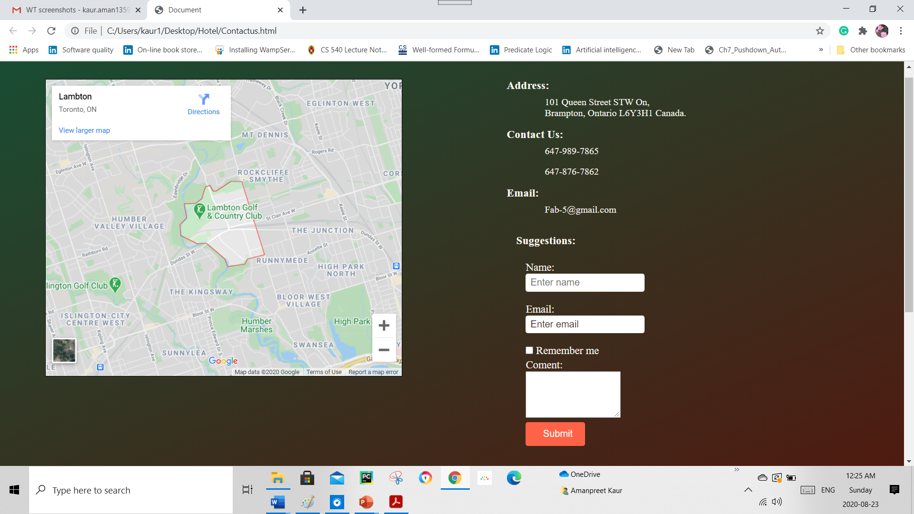
Contact Us

Slide 30
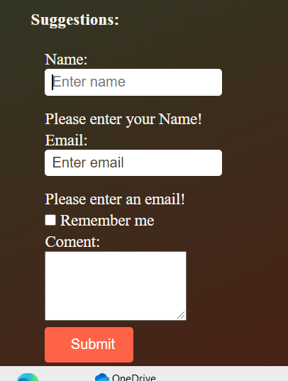
Validation on Empty Fields

Slide 31

Validation on Email Field

Slide 32
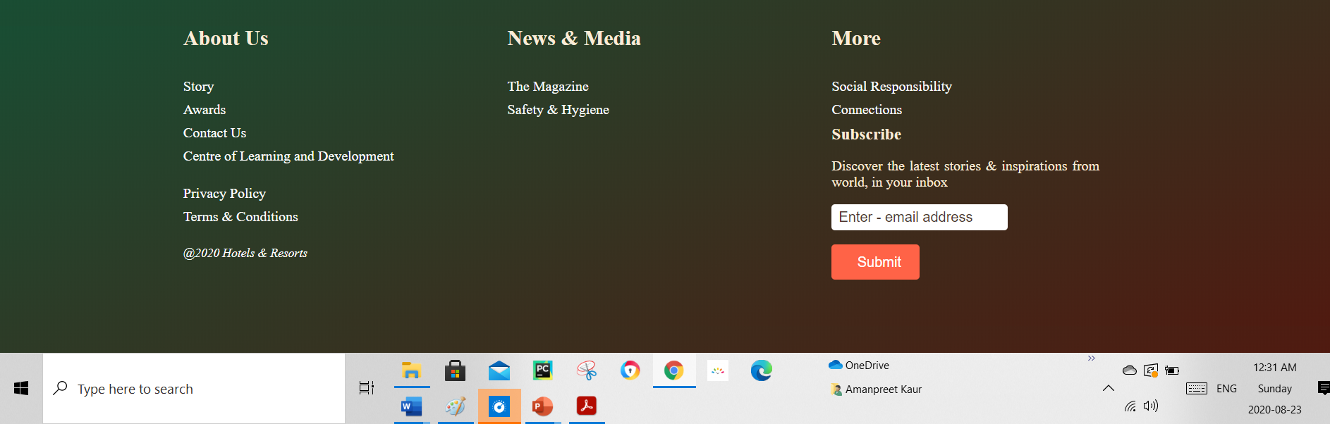
Footer

Slide 33
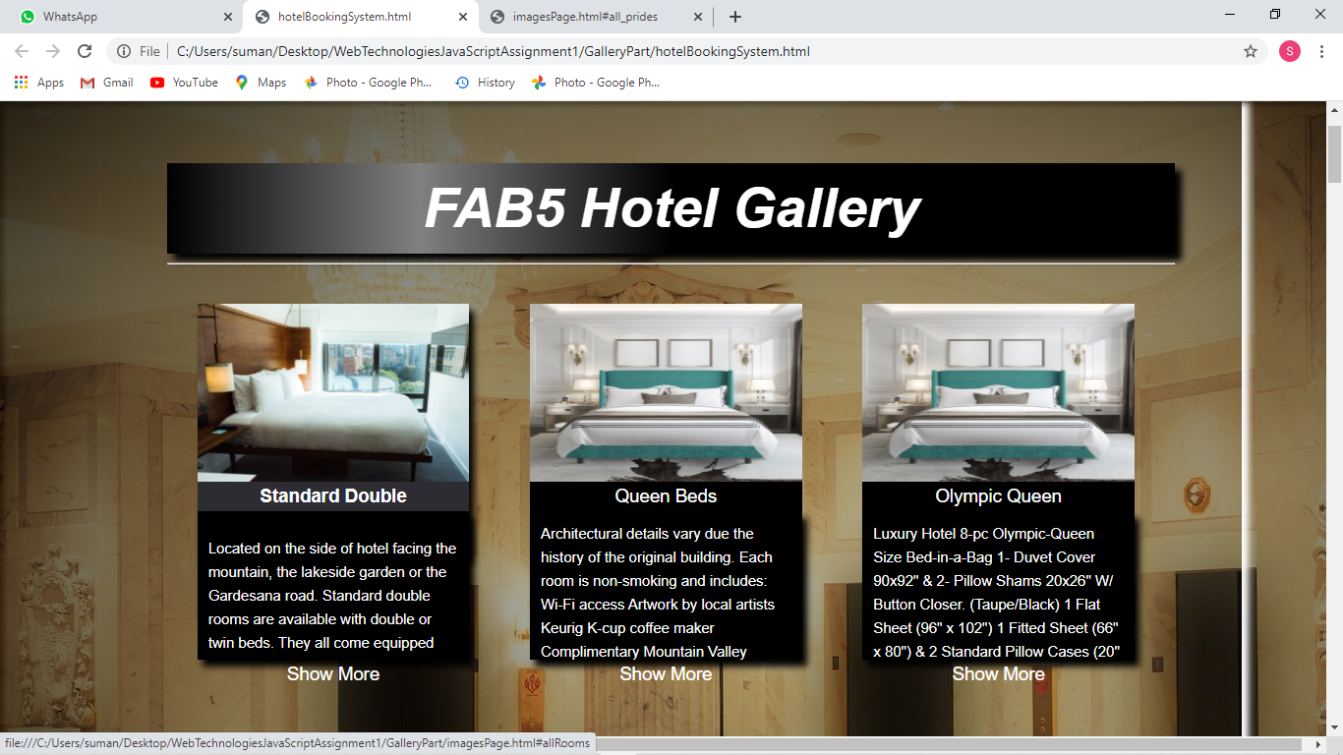
Gallery includes photos of

Slide 34
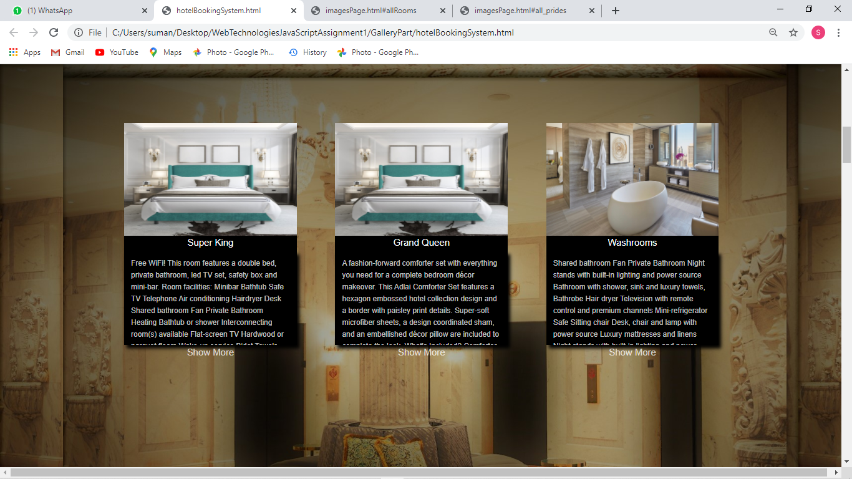
Gallery includes photos of

Slide 35
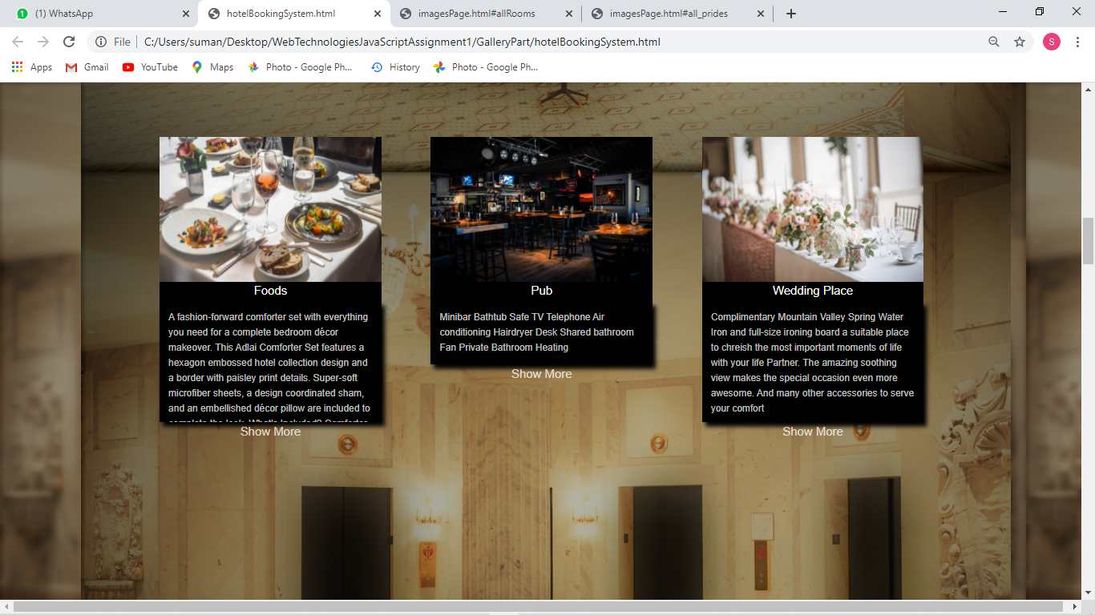
Gallery includes photos of

Slide 36
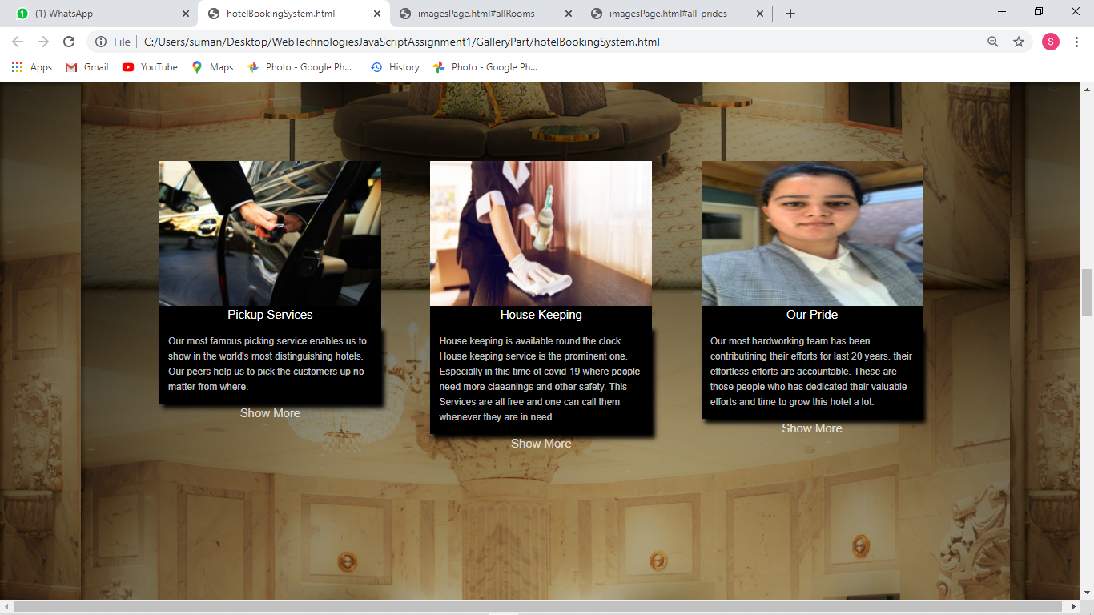
Gallery includes photos of

Slide 37
When ‘Show More’ text is clicked

Slide 38
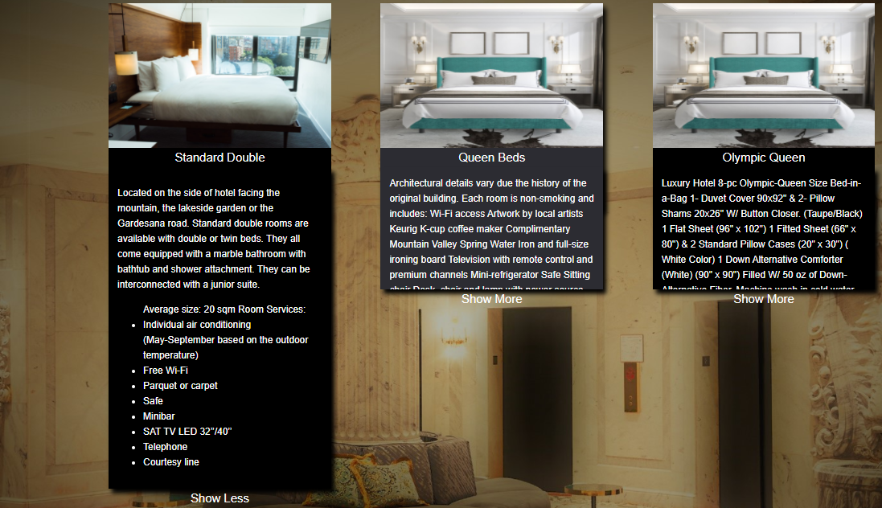
Expanding information after clicking on ’Show More’

Slide 39
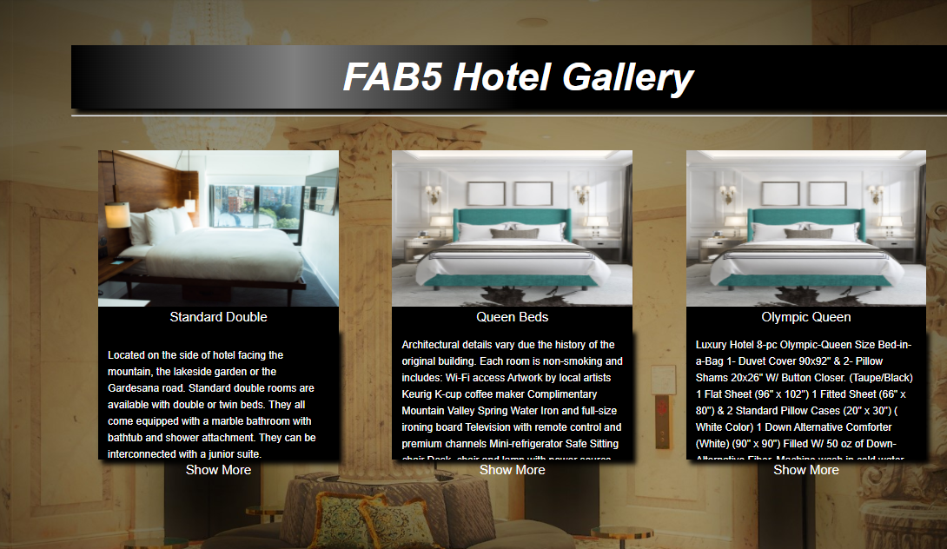
Again come in previous text

Slide 40
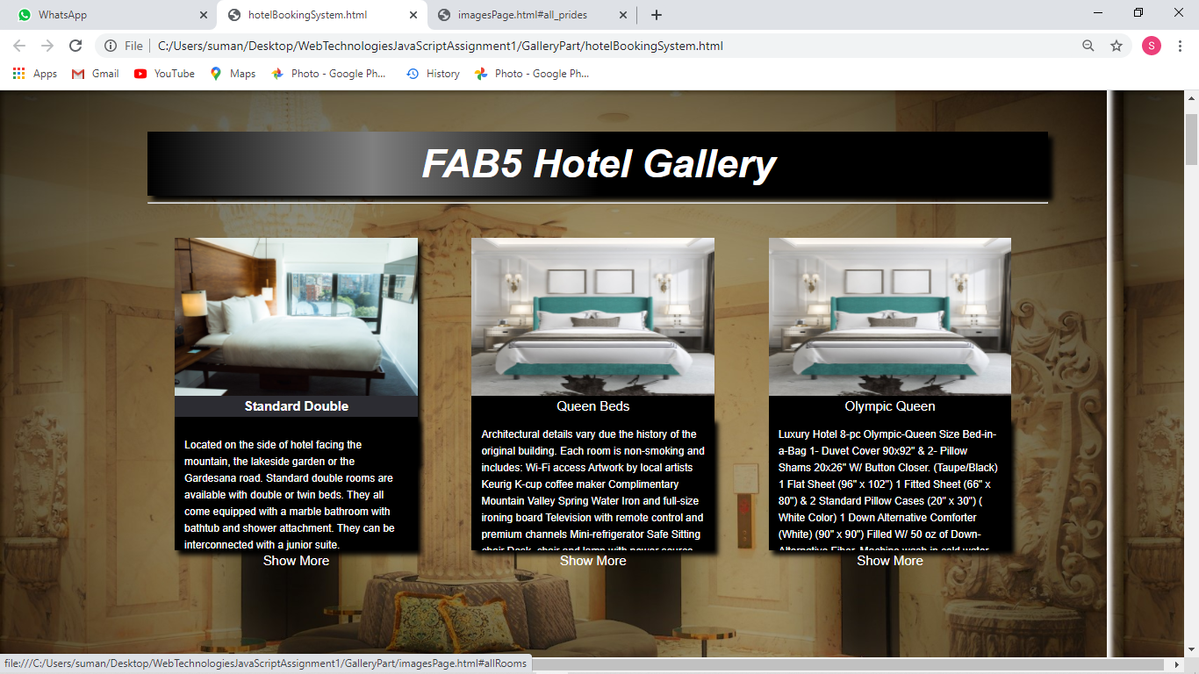
What happens after clicking on type of room..?

Slide 41
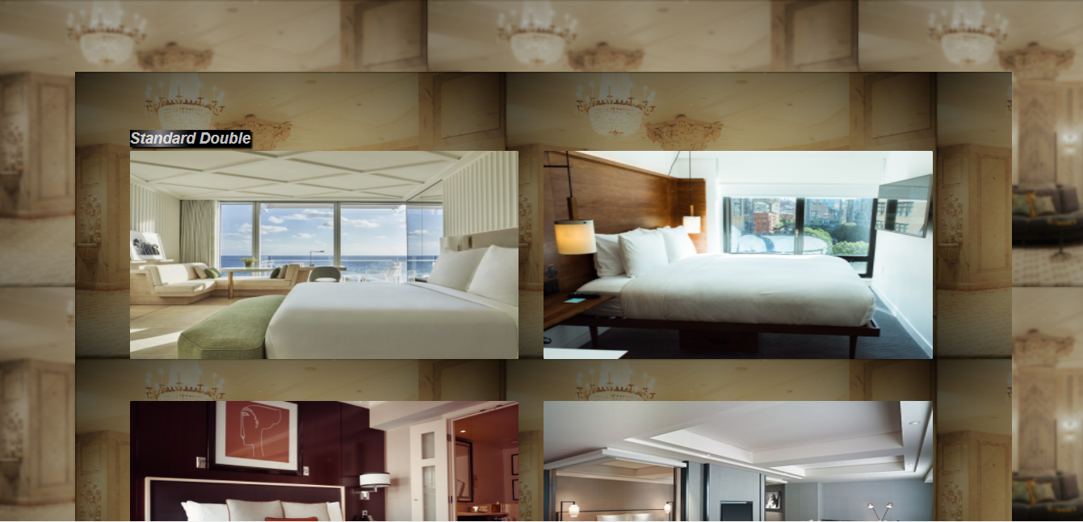
It shows page showing types of pictures

Slide 42
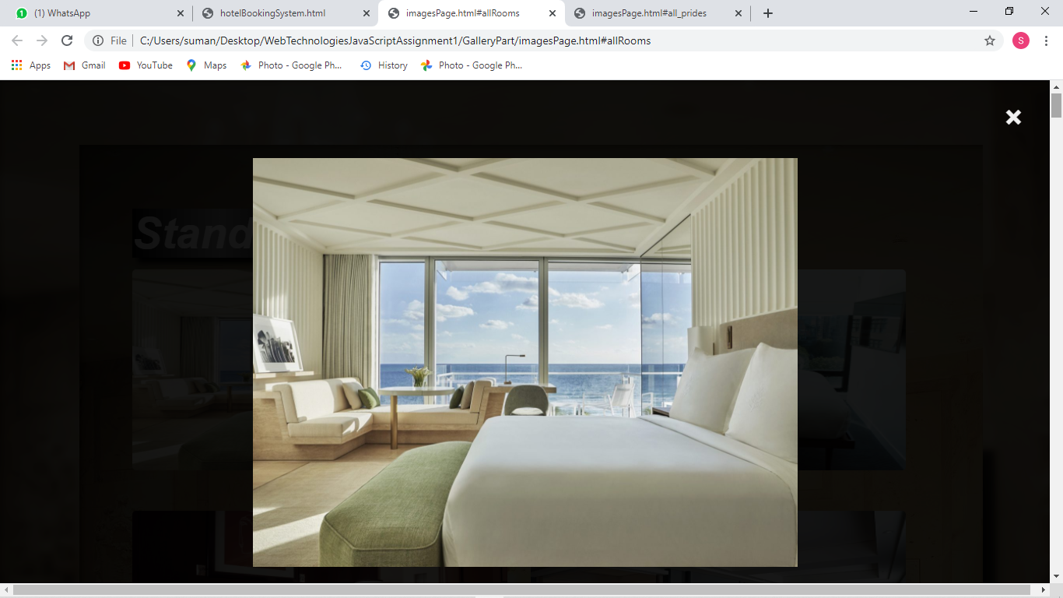
Pop up image after clicking on any image

Slide 43
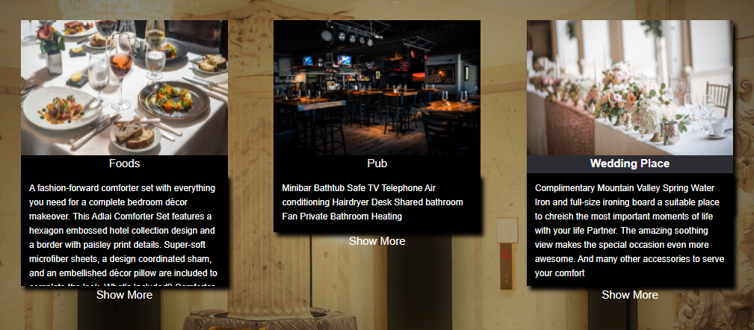
When Wedding Place is clicked

Slide 44
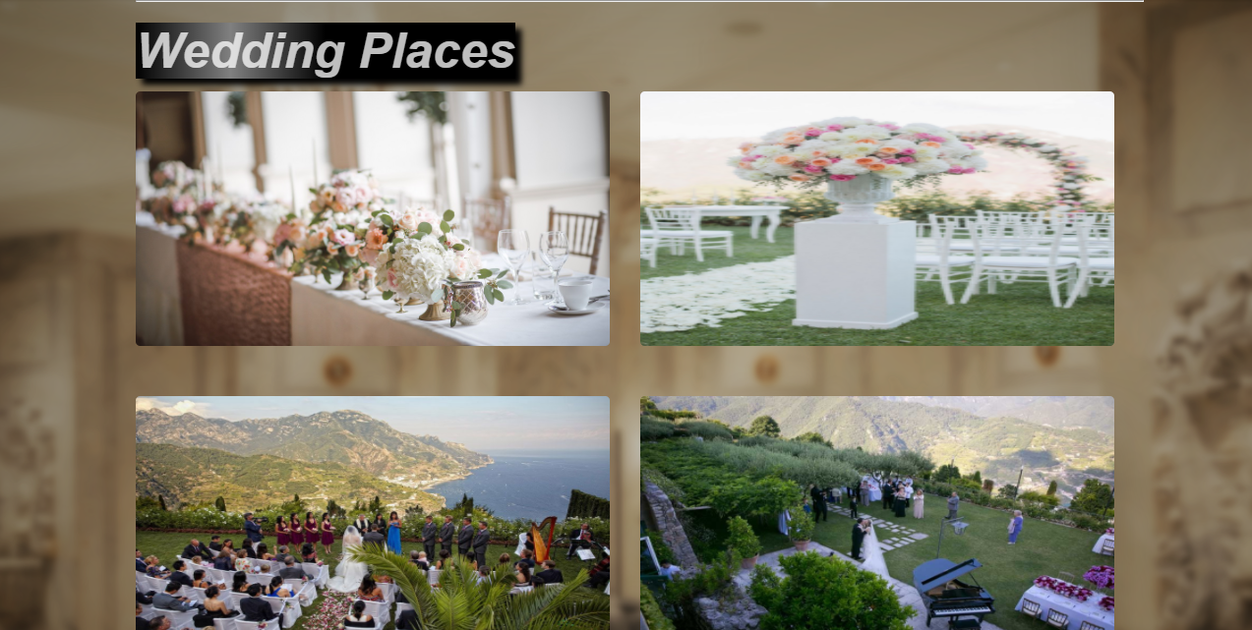
Wedding page link gets opened..

Slide 45
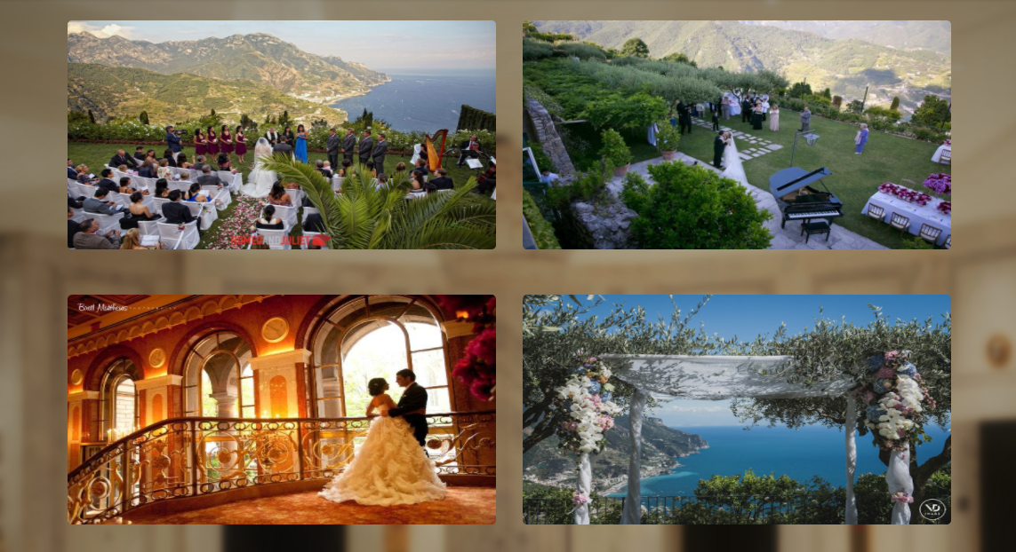
Wedding place images page..

Slide 46
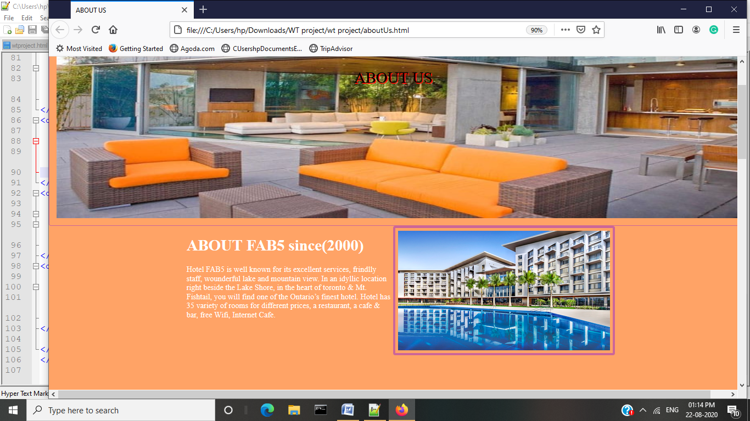
About Us

Slide 47
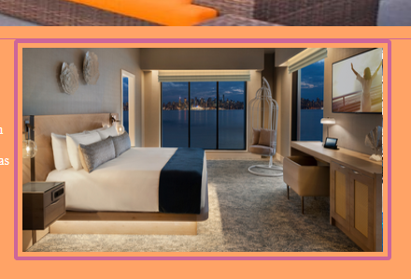
Usage of Plugin – About Us

Slide 48
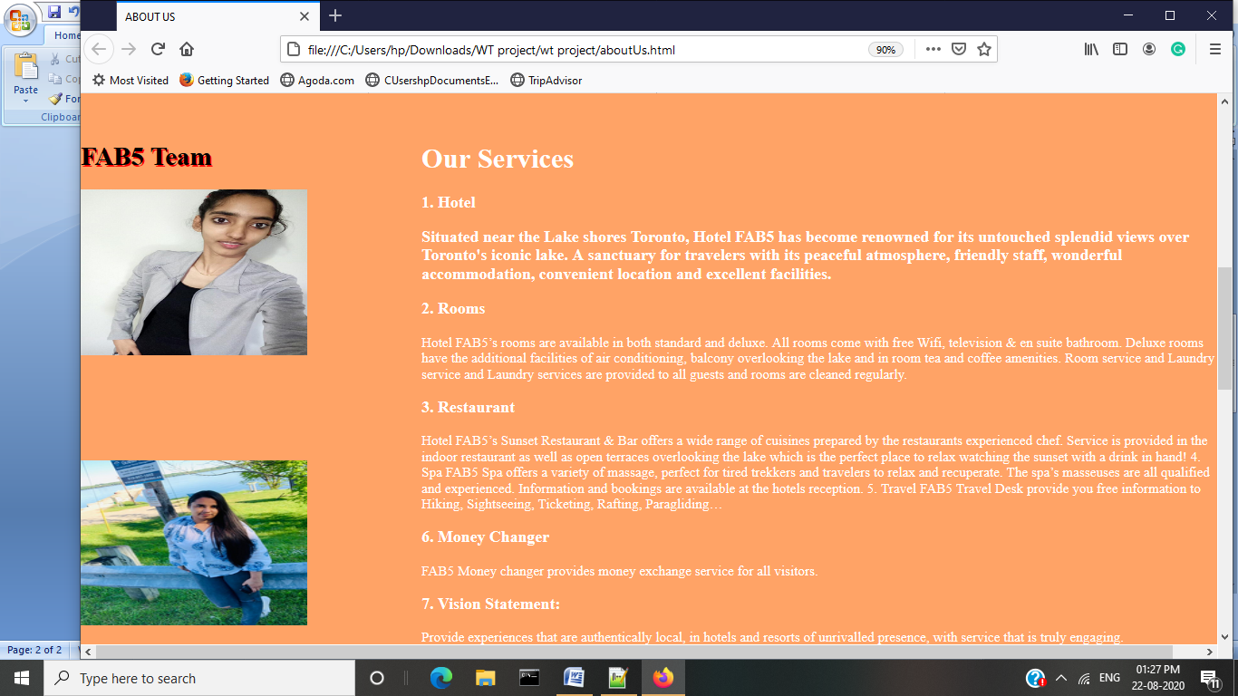
Services provided by Fab5

Slide 49
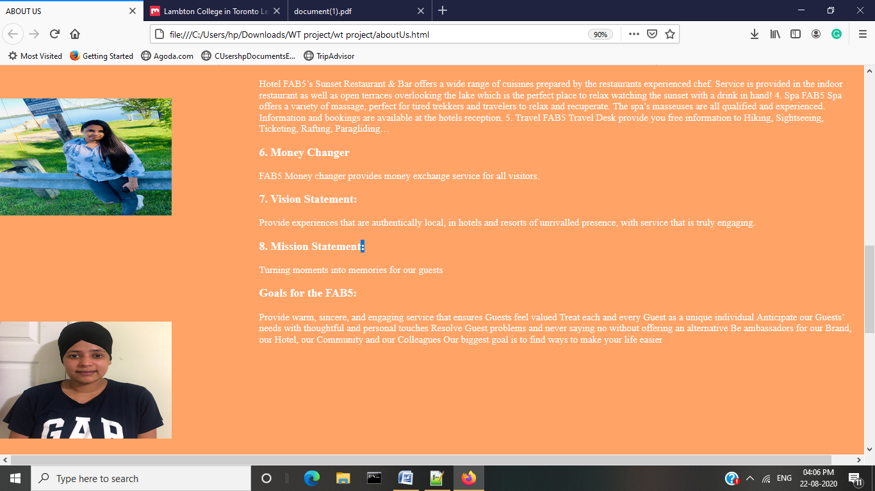
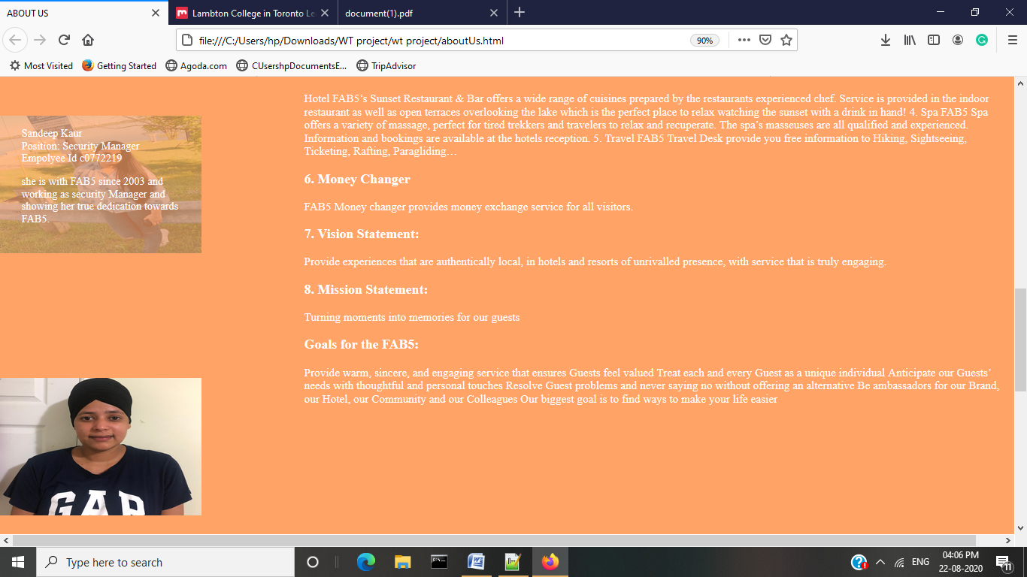
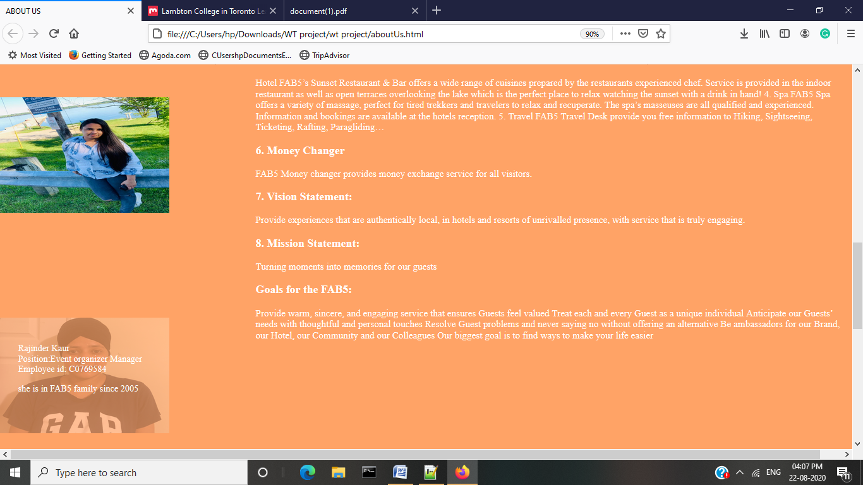
Gallery of Team members

Slide 50

Thank You..

